Slide 1
Cancer Cachexia in GI Malignancies

Slide 2
Malnutrition is the most underappreciated complication of gastrointestinal malignancies

Slide 3
Malnutrition and weight loss are prevalent in cancer patients

Slide 4
Weight loss and overall survival in gastrointestinal malignancy

Slide 5
Weight loss and clinical outcomes in gastrointestinal malignancy

Slide 6
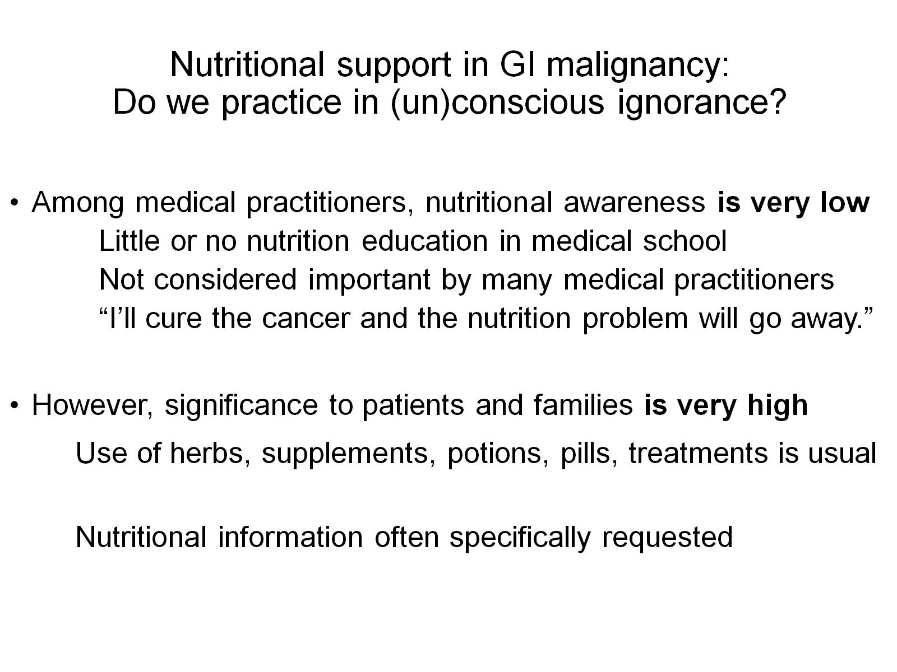
Nutritional support in GI malignancy: Do we practice in (un)conscious ignorance?

Slide 7
Cancer Cachexia: Definition

Slide 8
Sarcopenia: Definitions

Slide 9
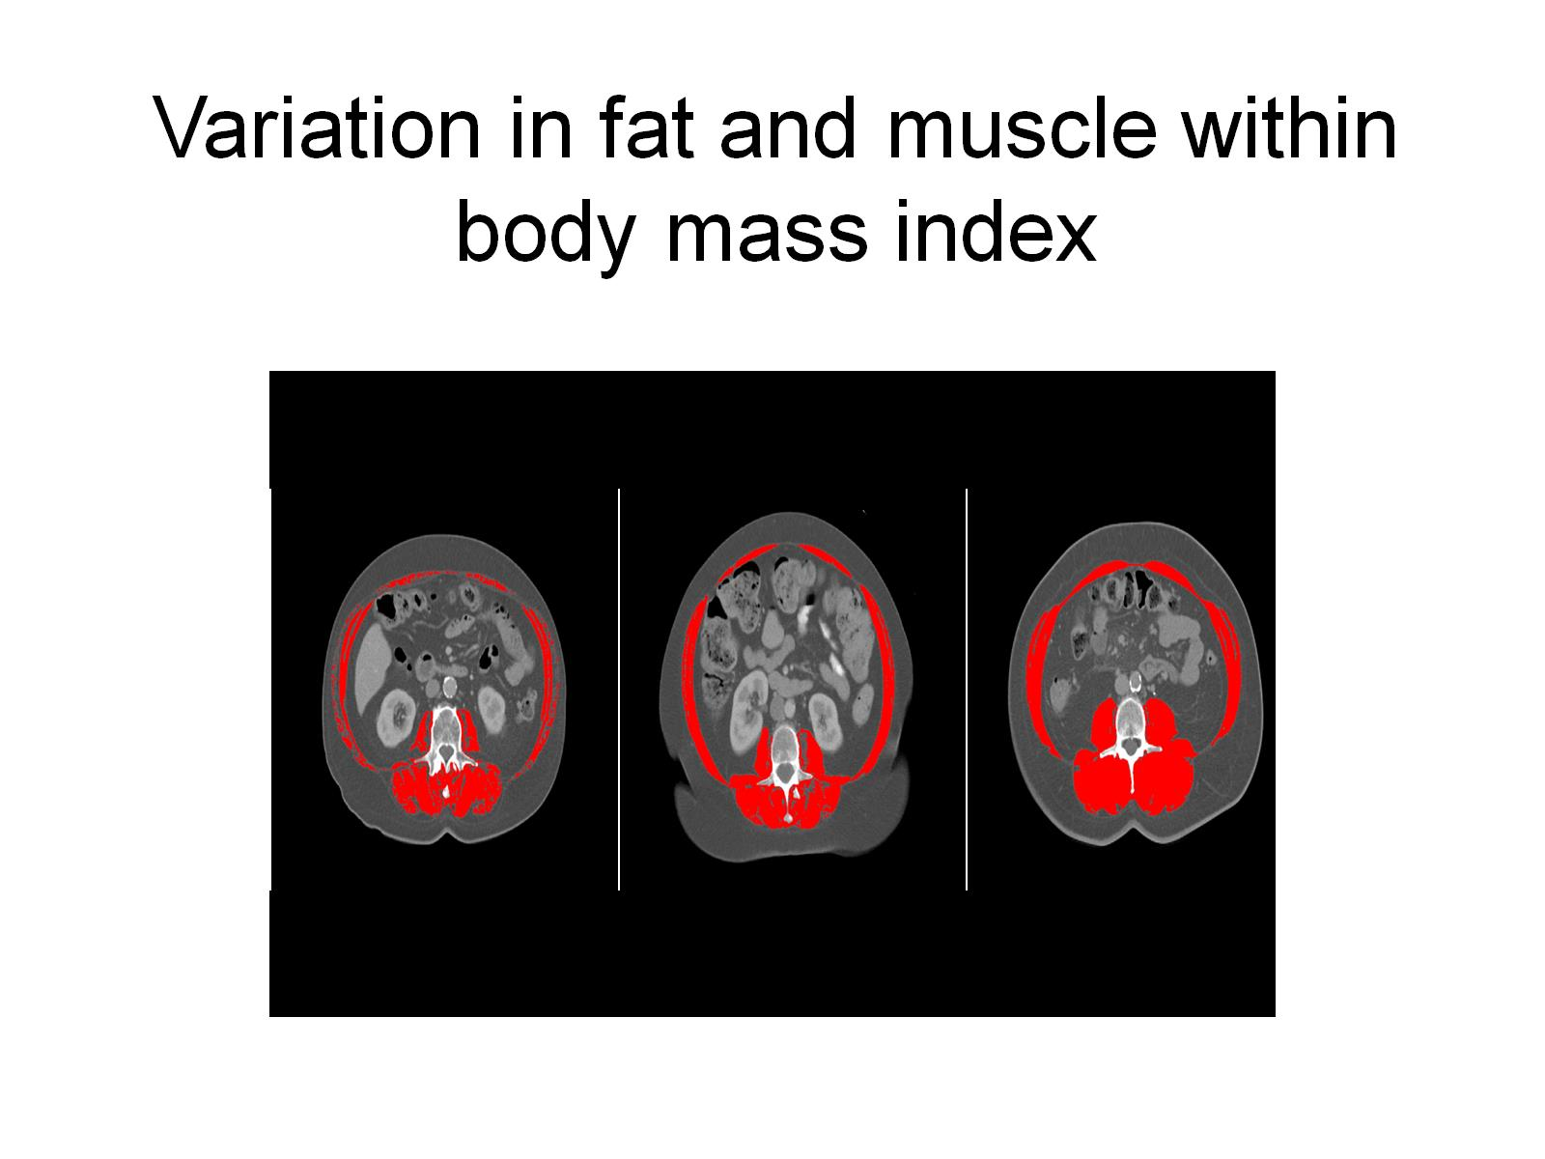

Slide 10
Malnutrition: Impact of sarcopenia

Slide 11
Malnutrition: Impact of sarcopenia

Slide 12
Malnutrition and systemic inflammation

Slide 14
Frequency of side effects and probability of malnutrition

Slide 15
Treatment-related side effects negatively impact nutritional status

Slide 16
Malnutrition affects all aspects of gastrointestinal oncology management

Slide 17
Nutritional intervention can improve quality of life

Slide 18
Nutritional intervention can improve functional outcomes

Slide 19
Nutritional intervention can improve QOL and OS in advanced pancreatic cancer

Slide 20
Stabilization of weight improves overall survival in colorectal cancer

Slide 21
Early nutrition intervention has been shown to improve outcomes in cancer patients

Slide 23
Nutritional support for GI malignancies requires a multidisciplinary team approach

Slide 24
The question(s) thus remain for nutritional support in GI malignancy: How do we???

Slide 25
Providing nutritional support in GI malignancy: The TARGET approach

Slide 26
Nutrition Pathway: Role of dietitian

Slide 27
Malnutrition Screening Tool

Slide 28
PG-SGA-SF

Slide 29
PG-SGA-SF

Slide 30
MST vs PG-SGA

Slide 31
Full Nutrition Assessment

Slide 32
Determining Nutrition Intervention

Slide 33
Nutrition Care Plan

Slide 34
Nutrition Care Plan

Slide 35
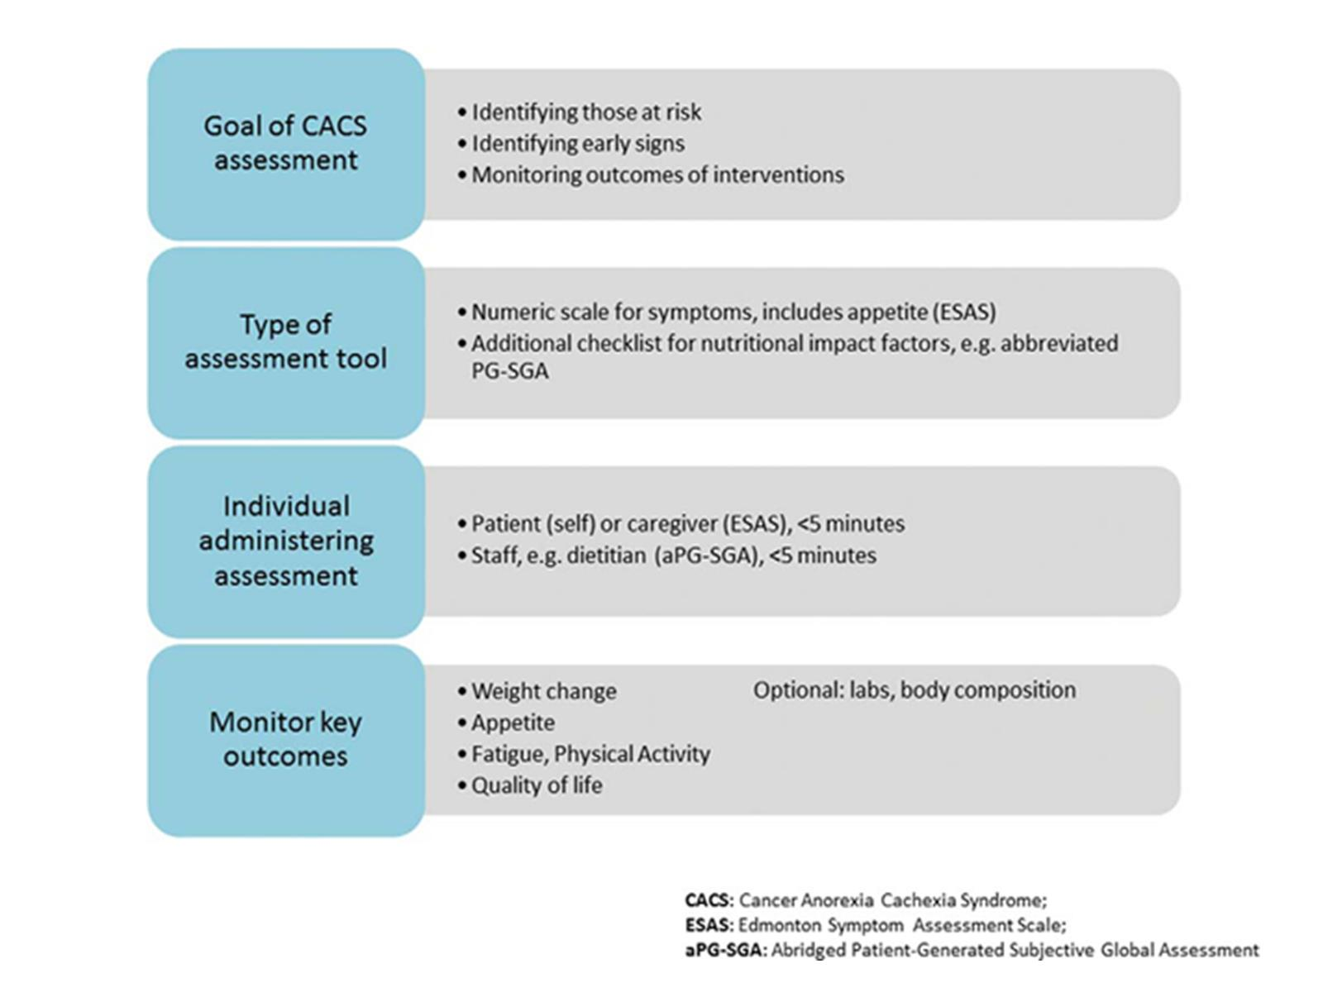

Slide 36
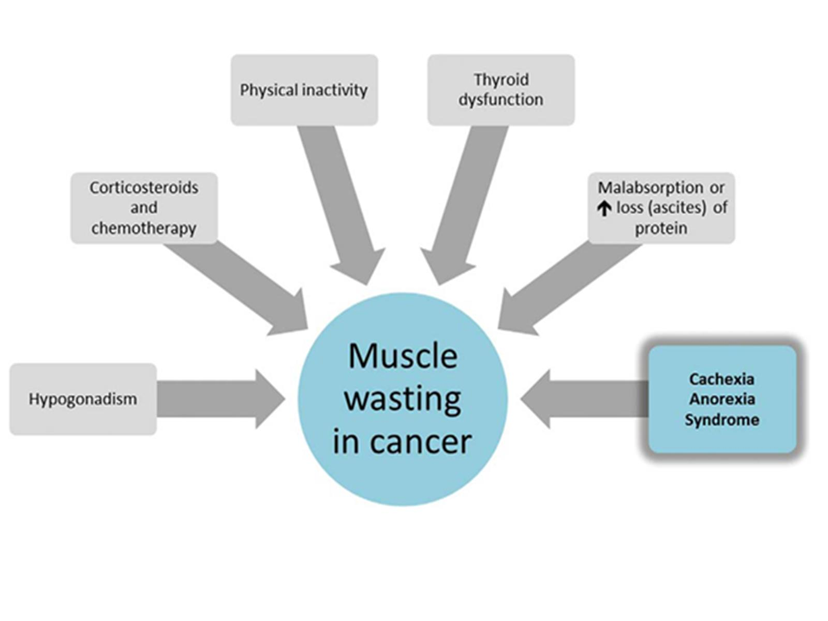

Slide 37
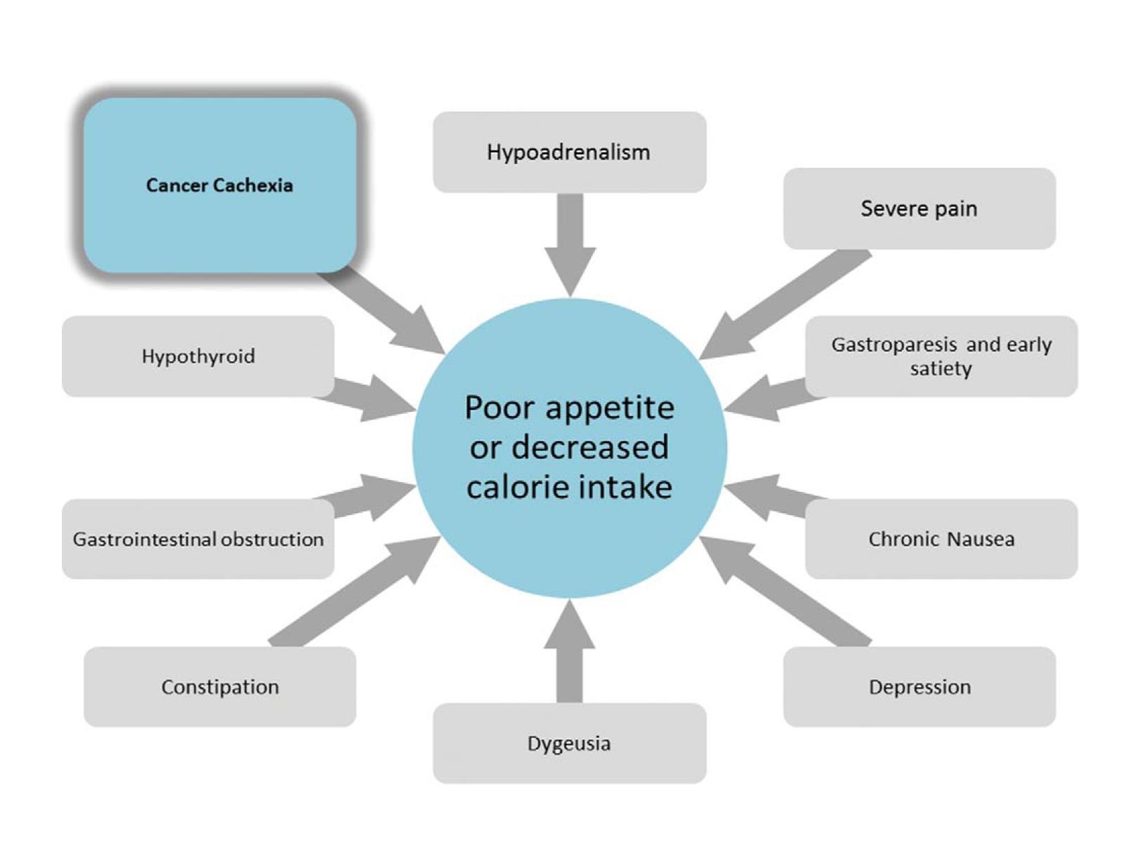

Slide 38
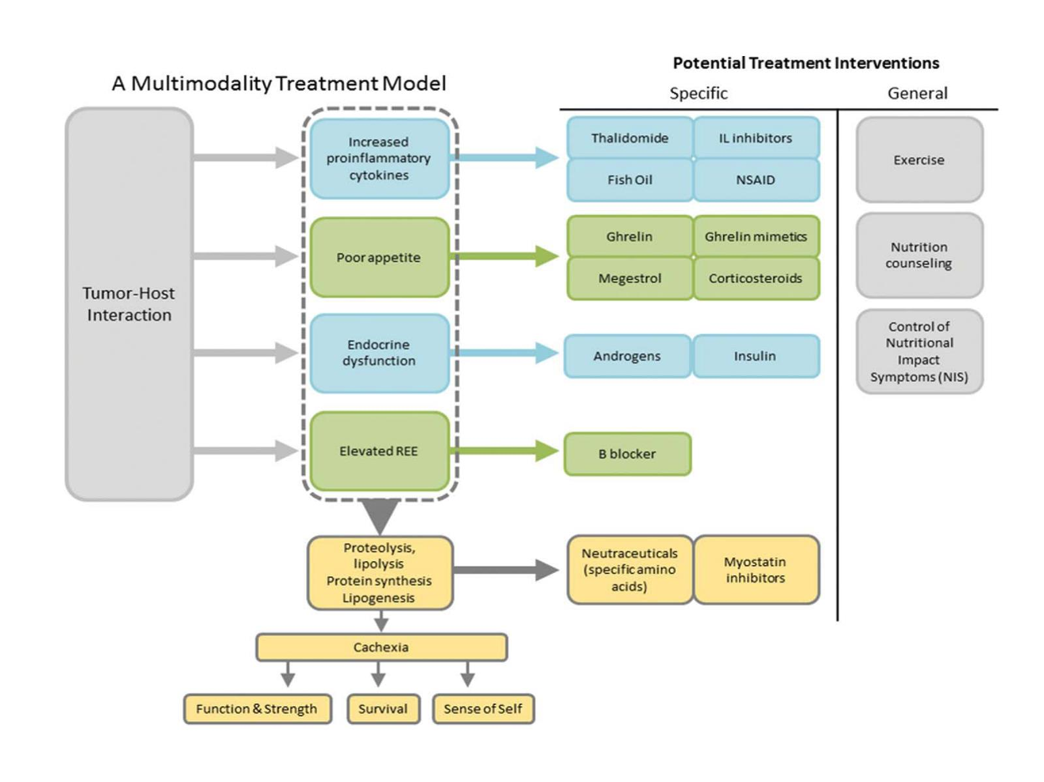

Slide 39
Cachexia in GI Malignancies: Pharmacological agents

Slide 40
Cachexia in GI malignancies: Investigational agents

Slide 41
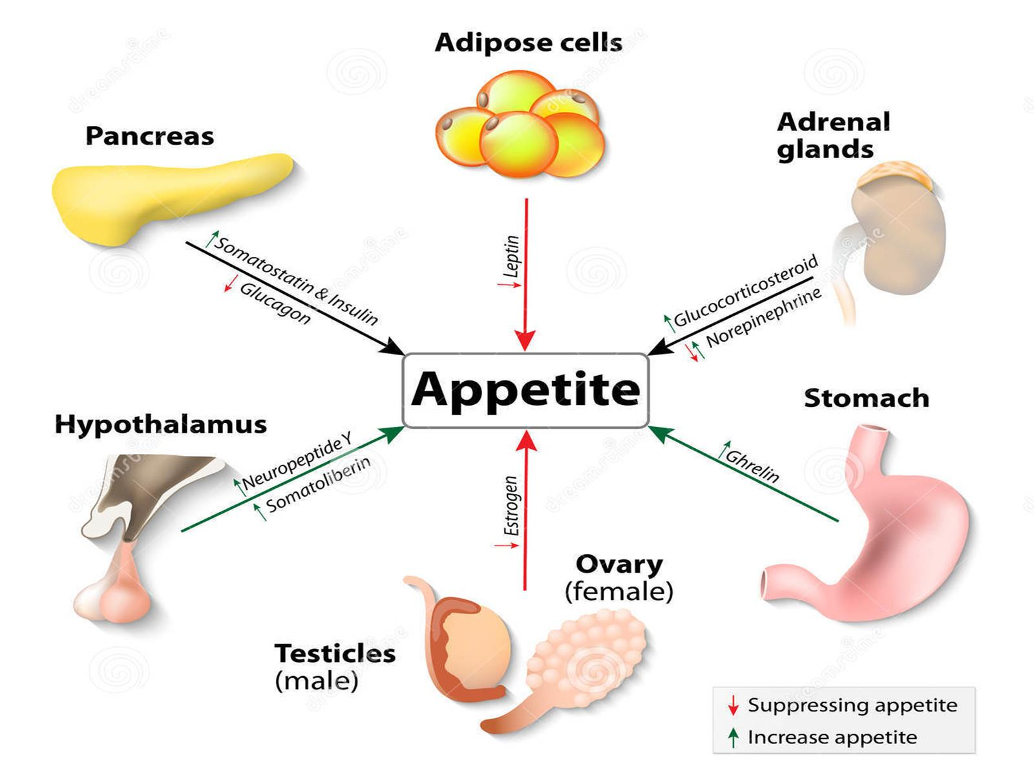

Slide 42
Managing cachexia in GI malignancy: How I do it

