Slide 1
Cost of & Access to
Molecularly Targeted Therapies as Barriers to Optimal Care
H. Jack West, MD
Swedish Cancer Institute
Seattle, WA
Global Resource for Advancing Cancer Education (GRACE)
www.cancerGRACE.org

Slide 2
Cost of Cancer Drugs is Rising Rapidly and Unsustainably
http://www.mskcc.org/research/health-policy-outcomes/cost-drugs

Slide 3
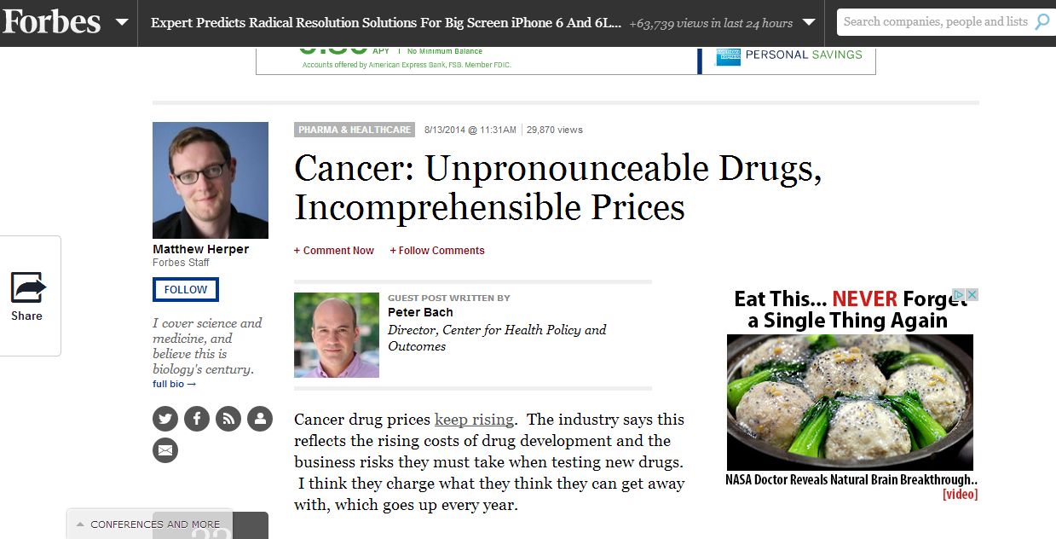
This is Leading to Controversy as We Try to Balance Obligation to Patients and to the Rest of Society

Slide 4
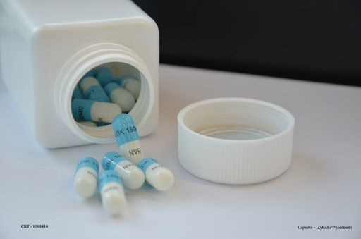
Ceritinib: New Treatment Option for ALK-Positive NSCLC
FDA Approved
April, 2014
Cost: $13,500/mo

Slide 5
LUX Lung-3, LUX Lung-6
LUX Lung-3
Sequist, JCO 2013
EGFR Mut’n Pos
Advanced NSCLC
No Prior Rx
N= 345
Global
R
A
N
D
Afatinib 40 mg PO daily
until progression
2:1
Cisplatin/Alimta up to 6 cycles
Primary endpoint: PFS
LUX Lung-6
Wu, Lancet 2014
EGFR Mut’n Pos
Advanced NSCLC
No Prior Rx
N= 364
Asia
R
A
N
D
Afatinib 40 mg PO daily
until progression
2:1
Cisplatin/Gemcitabine
up to 6 cycles
Primary endpoint: PFS

Slide 6
Treatment after Progression on First Line Therapy (Del 19 and L858R only)
 | LUX-Lung 3 |  |  | LUX-Lung 6
 | Afatinib (n=203) | Pem/Cis (n=104) |  | Afatinib (n=216) | Gem/Cis (n=108)
Discontinued treatment, n (%) | 184 (100) | 104 (100) |  | 194 (100) | 108 (100)
Subsequent systemic therapy, n (%)† | 144 (78) | 88 (85) |  | 123 (63) | 70 (65)
Chemotherapy, n (%) | 131 (71) | 49 (47) |  | 114 (59) | 29 (27)
EGFR TKI therapy, n (%) Erlotinib Gefitinib Afatinib AZD9291 Dacomitinib Icotinib EGFR TKI combinations | 81 (44) 61 (33) 28 (15) 2 (1) 2 (1) – – 5 (3) | 78 (75) 46 (42) 44 (42) 7 (7) 1 (1) 1 (1) – 9 (9) |  | 50 (26) 21 (11) 19 (10) – – – 11 (6) 5 (3) | 61 (56) 22 (20) 39 (36) – – – 3 (3) 3 (3)
Other systemic therapy±, n (%) | 5 (3) | 2 (2) |  | 3 (2) | 4 (4)
Radiotherapy, n (%) | 32 (17) | 21 (20) |  | 4 (2) | 0 (0)
†Collection of data on subsequent therapies still ongoing.
± include investigational agents, monoclonal antibodies, non-EGFR targeting protein kinase inhibitors etc
Yang, ASCO 2014, A#8004

Slide 7
Treatment after Progression on First Line by Country’s Reimbursement*
 | Countries with universal reimbursement policies** |  |  | Countries without universal reimbursement policies***
 | Afatinib (n=144) | Chemo (n=75) |  | Afatinib (n=275) | Chemo (n=137)
Discontinued treatment, n (%) | 127 (100) | 75 (100) |  | 251 (100) | 137 (100)
Subsequent systemic therapy, n (%) | 112 (88) | 69 (92) |  | 158 (63) | 89 (65)
Chemotherapy, n (%) | 103 (81) | 35 (47) |  | 142 (57) | 43 (31)
EGFR TKI, n (%) | 76 (60) | 68 (91) |  | 55 (22) | 71 (52)
Other, n (%) | 5 (4) | 2 (3) |  | 3 (1) | 4 (3)
Radiotherapy, n (%) | 27 (22) | 18 (24) |  | 9 (4) | 3 (2)
*Determined by presence or absence of a national reimbursement policy in effect throughout the period of trial conduct:
**Main countries contributing : Japan, Taiwan, Korea, Germany, France, Australia, UK, Belgium
***Main countries contributing : China, Thailand, Russia, the Philippines, Malaysia
Yang, ASCO 2014, A#8004

Slide 8
Avastin/Tarceva vs. Tarceva Alone for Advanced EGFR Mutation-Positive NSCLC
Tarceva daily
+ Avastin IV once every 3 weeks
until progression or prohibitive toxicity
Adv NSCLC
EGFR Mut’n (exon 19/21)
Treatment-naïve
N = 154
R
A
N
D
Tarceva daily
until progression or prohibitive toxicity
Primary endpoint: PFS
Kato, ASCO 2014,
A#8005

Slide 9
Cost Considerations with Tarceva/Avastin Combination
Cost/
Month
($USD)
Tarceva
Tarceva/
Avastin
Addition of Avastin increases cost of first line treatment by ~$120,000 for 16 treatments (acquisition cost alone)

Slide 10
In 2014, Cost/Value of Therapy is a Factor in Cancer Care
Cost matters, especially as new drugs have eclipsed the prior $10,000/mo barrier
With limited societal resources, treatment benefits need to be clinically significant and have some semblance of value
Appropriate to address it openly and not just have it bias our clinical judgment
Cost is limiting our ability to deliver best treatment
Optimal Rx
($$$$)
Drug delivery
to needy patients
Cost/practical
limits

Slide 11
How Do You See Drug Costs Affecting Cancer Treatment?
Are people unable to get needed agents?
Psychological or financial stress?
How do you see the cost debate?
How much does cost limit access to trials?
Is it more an issue of interest in research? Education?

