Slide 1
What is Acquired Resistance? and How Does it Occur?
Gregory J. Riely
@RielyMD

Slide 2
Primary Resistance
Kwak EL, et al. NEJM 2010;363:1693-1703.

Slide 3
Acquired Resistance

Slide 4
Acquired Resistance
Kwak EL, et al. NEJM 2010;363:1693-1703.

Slide 5
Crizotinib improves PFS compared to chemo
Shaw et al, NEJM 2013

Slide 6
Definition of Acquired Resistance
Jackman et al JCO 2010

Slide 7
How Does Drug Resistance Occur?
Holohan et al, Nature Reviews Cancer 2013

Slide 8
How Does Drug Resistance Occur?
Holohan et al, Nature Reviews Cancer 2013

Slide 9
Resistance Due to Altered Drug Distribution

Slide 10
Overcoming Resistance Due to Altered Drug Distribution
Treated with Pulsatile Erlotinib 1500 mg weekly x 5 months
Grommes et al, Neuro Oncol 2011

Slide 11
Resistance Due to Altered Drug Distribution

Slide 12
Overcoming Resistance Due to Altered Drug Distribution
Treated with “Locally Ablative Therapy”
Weickhardt et al, JTO

Slide 13
How Does Drug Resistance Occur?
Holohan et al, Nature Reviews Cancer 2013

Slide 14
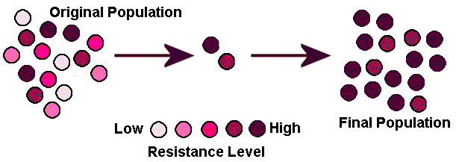
Natural Selection for Resistance
Drug Treatment

Slide 15
Selection for Resistance in
EGFR Mutant Lung Cancer
Riely G J et al. Clin Cancer Res 2006;12:7232-7241
Notes:
A model for EGFR-dependent tumor maintenance that accounts for the lack of complete response to treatment with gefitinib or erlotinib (see text for details).

Slide 16
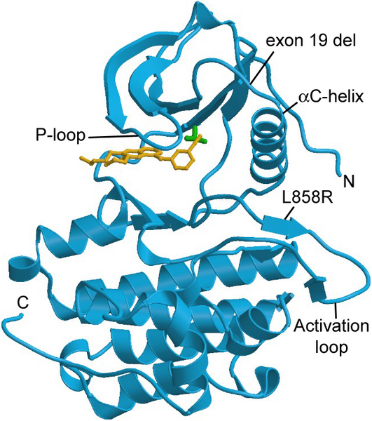
Erlotinib Bound to the EGFR Kinase Domain
Clark J, Cools J, Gilliland DG (2005) PLoS Med 2005

Slide 17
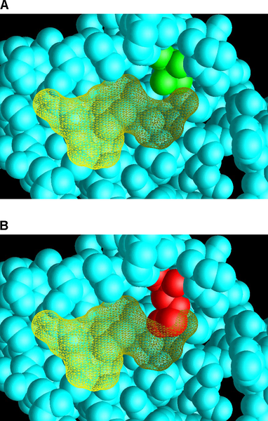
Structural Models of EGFR Showing T790M
Clark J, Cools J, Gilliland DG (2005) PLoS Med 2005

Slide 18
Natural Selection for Resistance
Drug Treatment

Slide 19
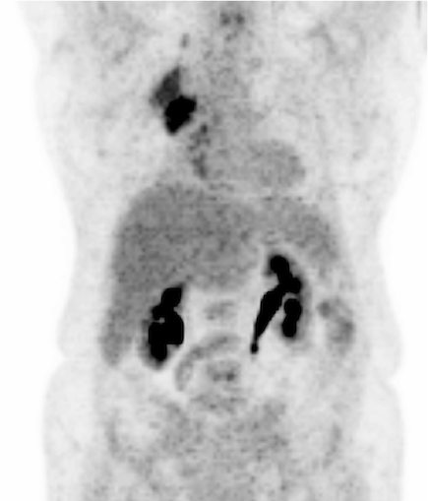
Disease Flare
Last day of TKI
Day 0
Riely et al Clin Cancer Res. 2007

Slide 20
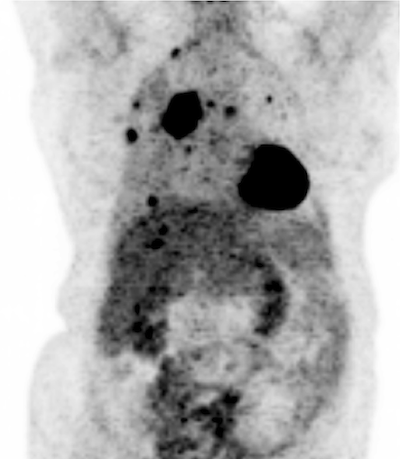
Disease Flare
Last day of TKI
Off EGFR TKI
Day 0
Day 21
Riely et al Clin Cancer Res. 2007

Slide 21
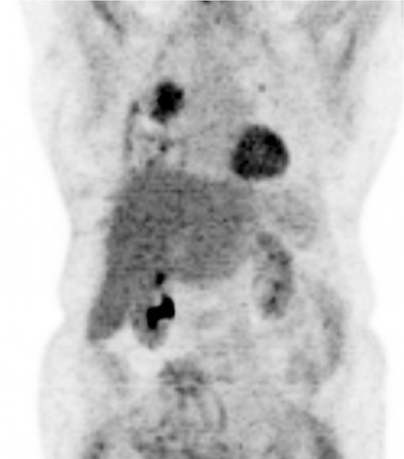
Disease Flare
Last day of TKI
Off EGFR TKI
Resumed TKI
Day 0
Day 21
Day 42
Riely et al Clin Cancer Res. 2007

Slide 22
How Does Drug Resistance Occur?
Holohan et al, Nature Reviews Cancer 2013

Slide 23
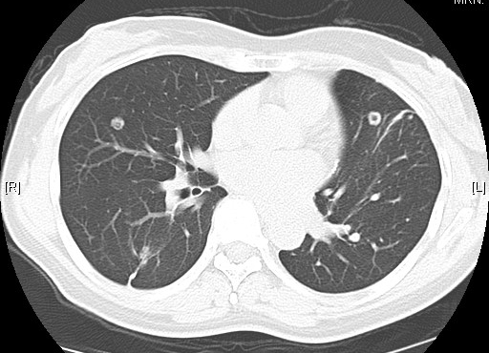
Each site can develop resistance (or not) in its own way

Slide 24
How Does Drug Resistance Occur?
Holohan et al, Nature Reviews Cancer 2013

Slide 25
Conclusions
Acquired Resistance is Different from Primary Resistance
Resistance can happen in many ways
Targeting resistance depends on the type of resistance that is observed

