Slide 1
Leveraging Patient Engagement
&
the Role of Advocacy

Slide 2
OVERVIEW
Lung Cancer is a Global Epidemic.
It requires a global solution.
Collaboration with all stakeholders, especially patients, is required to transform lung cancer into
a survivable disease.

Slide 3
OVERVIEW
HOW can we accomplish this goal?
We all must commit to helping all patients/survivors and
those yet to be diagnosed.
Through patient education, awareness and advocacy and in collaboration/partnership with the leaders in oncology, technology, science, medicine and philanthropy, we can raise awareness and fund research that will lead to better, more effective detection and treatments.
We are convinced that personalized medicine is the gateway to success and we can power progress by involving patients, donors, clinicians, pharmaceutical and biotech companies, payers, government and public and private enterprise.

Slide 4
OVERVIEW
Educated and Informed Patients
Are Empowered Patients
&
Empowered Patients Survive Longer!

Slide 5
TECHNOLOGY
Most advocacy groups use technology to educate and inform their patient constituency via webex or on-line summits.
Notes:
Educated patients are empowered patients, our Living Room Support Group educated patients so they have the knowledge to advocate for the best possible care available.

Slide 6
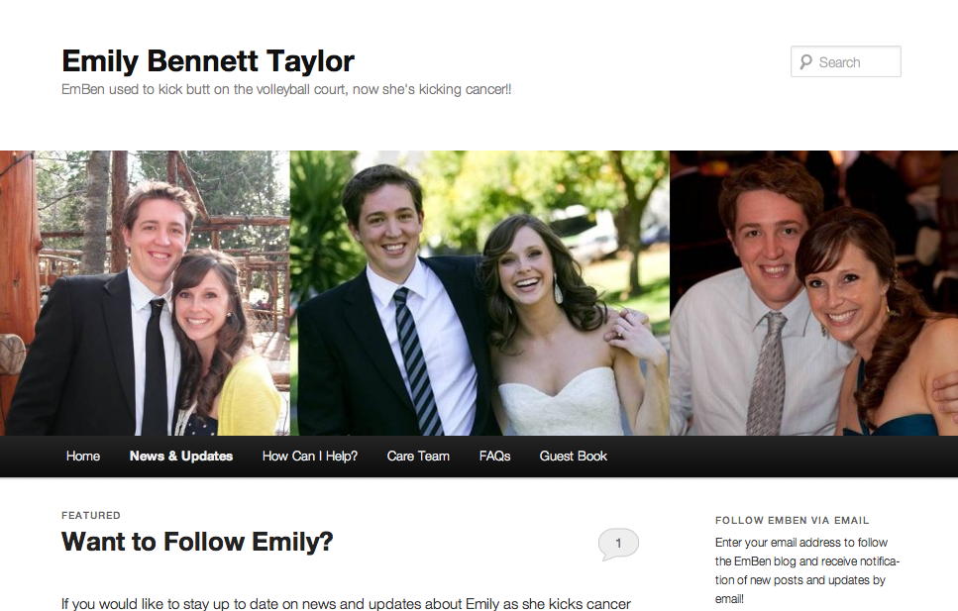
PATIENT COMMUNITIES
There are a multitude of patient communities, blogs and information sharing platforms for patients to engage with their peers.

Slide 7
SOCIAL MEDIA
Social media has become a daily communication tool to mobilize efforts, help raise awareness and educate the world that anyone can get lung cancer.

Slide 8
COLLABORATIONS
There are also several key collaborations happening in the lung cancer community to the benefit of patients.
Lung Cancer Ponatinib Trial Molecular Testing Phase
A phase II study of ponatinib in cohorts of patients with lung cancer preselected using different candidate predictive biomarkers (Principal Investigator: D. Ross Camidge, MD PhD)

Slide 9
ADVOCACY AWARENESS
Working together, we can make a difference.

